Slide 1

NCVO RESEARCH
TIME WELL SPENT - VOLUNTEERING
by Amy McGarvey
Notes:
This survey was conducted in 2023 by NVCO and is a national survey with a sample of 1271 volunteers, of which 79 were Student Volunteers.
This presentation focuses mainly on data about the Student Volunteers.

Slide 2
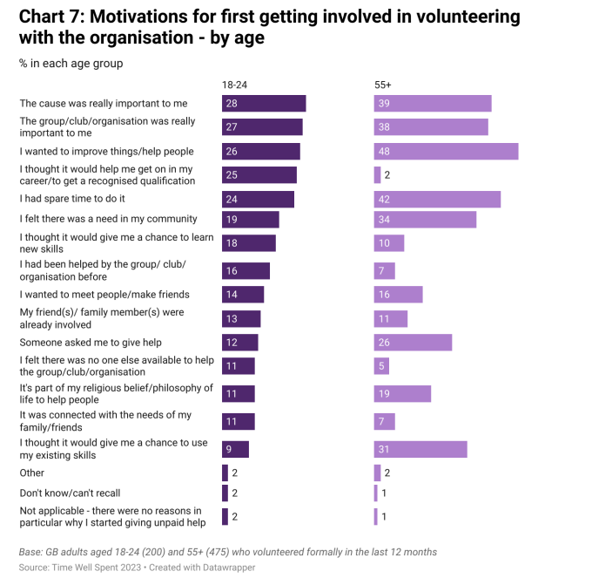
MOTIVATION TO GET INVOLVED
2
NVCO Survey 2023
Notes:
The survey asked participants what their motivation was to get involved in volunteering. Here we can see on the left the answer by 18 to 24 year olds compared to age 55+ .
Key to the younger age group is that it would help them get on the career ladder or get a qualification, or it would be a chance to learn new skills.

Slide 3
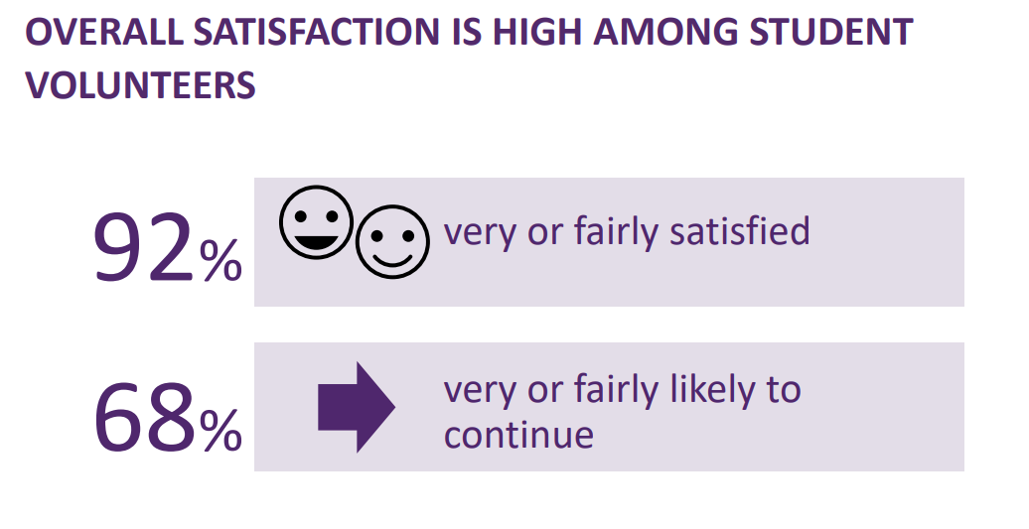
3
VOLUNTEER SATISFACTION
NVCO Survey 2023

Slide 4
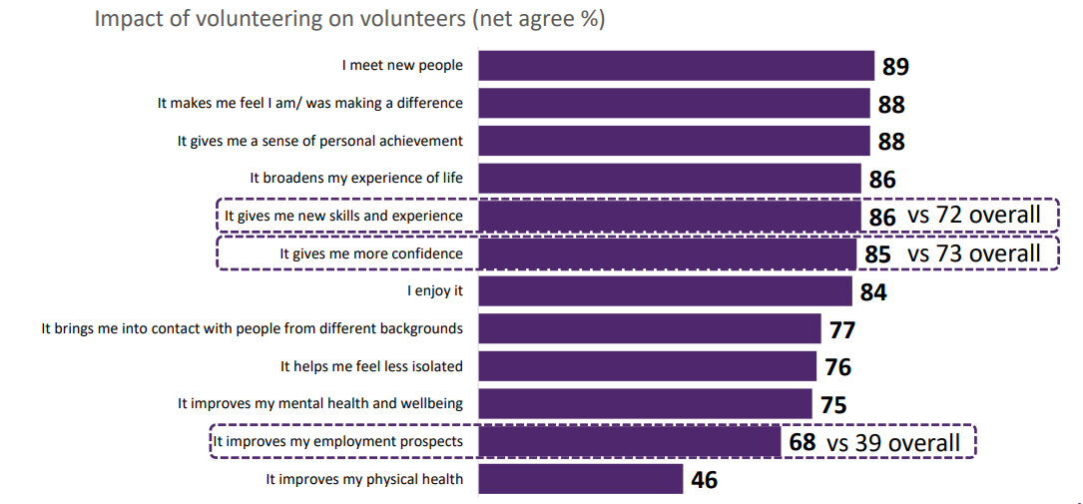
4
IMPACT ON VOLUNTEERS
NCVO Survey 2023
Notes:
With impact of volunteering experience on volunteers, for the younger age group more said it was important at giving them new skills and experience and more confidence, as well as improving employment prospects.

Slide 5
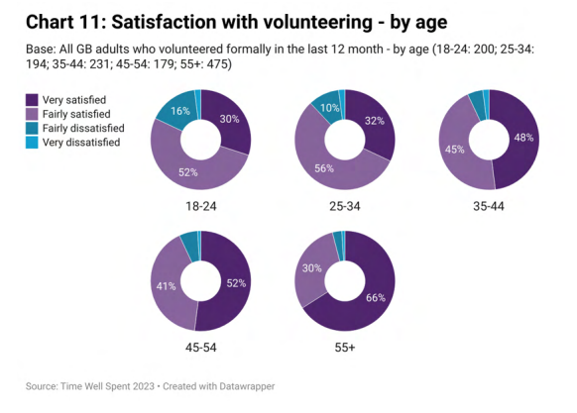
SATISFACTION BY AGE
5
NVCO Survey 2023
Notes:
The 18 to 24 age group demonstrated more dissatisfaction with volunteering than other age groups.

Slide 6
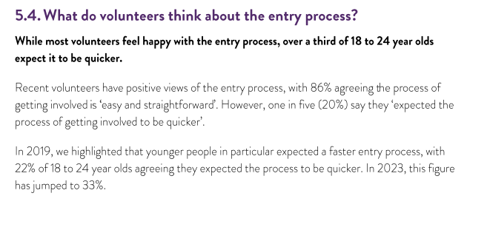
6
ENTRY PROCESS
NVCO Survey 2023
Notes:
33% of 18 to 24 year olds would like a faster entry process into volunteering.
This is something that SUBU will be reviewing for the coming academic year.

Slide 7
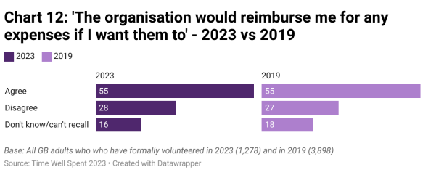
7
EXPENSES
NVCO Survey 2023
Notes:
Similar stats here compared to the previous survey of 2019 just over half of survey participants 55% agree that the organisation they volunteer with would reimburse expenses.

Slide 8
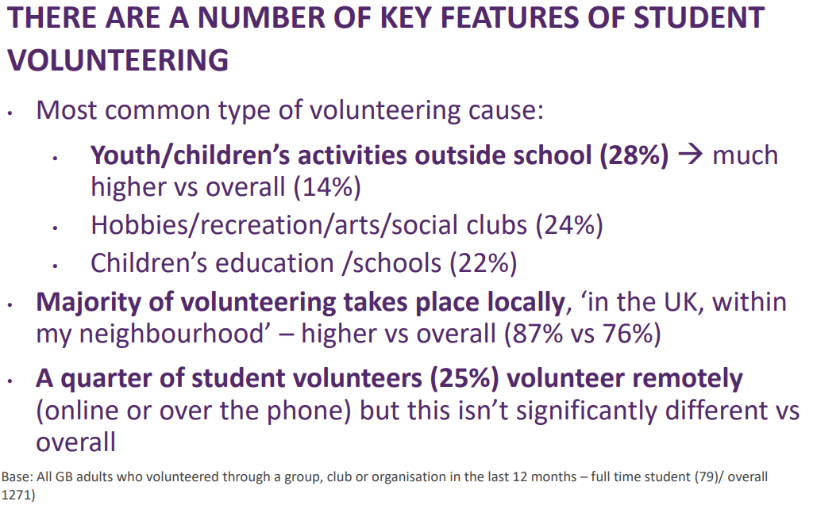
8
KEY FEATURES
NCVO Survey 2023
Notes:
Students like to volunteer with youth and children’s activities outside of school, with 87% volunteering locally, in the UK within their neighbourhood.
A quarter of students like to volunteer remotely.

Slide 9
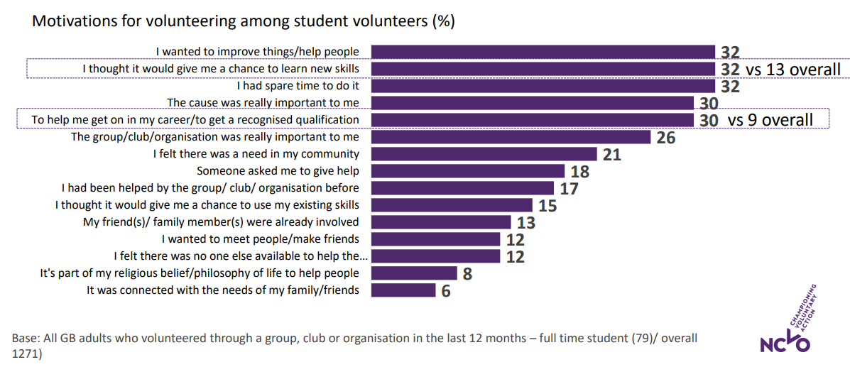
9
MOTIVATIONS
NCVO Survey 2023
Notes:
Reasons why students like to volunteer – 32% said they thought it would be a chance to learn new skills compared to 13% of the over all volunteers in the survey.
30% said it was to help with career or get a recognised qualification compared to 9% of the overall volunteers in the survey.

Slide 10
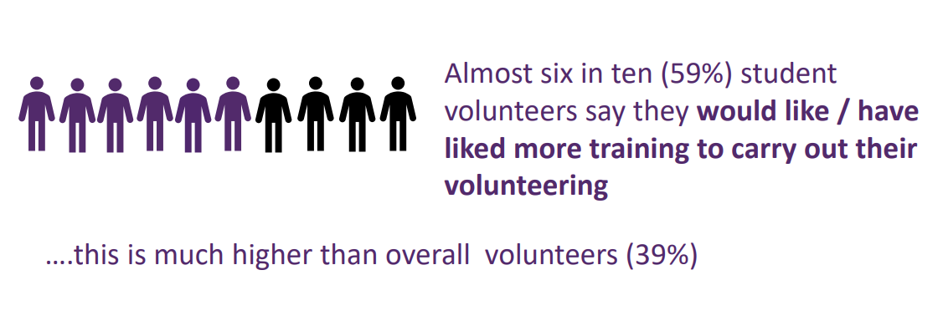
10
TRAINING
NVCO Survey 2023
Notes:
Six in ten student voluneers aid they would like more training to carry out their volunteering – higher than overall volunteers (39%)

Slide 11
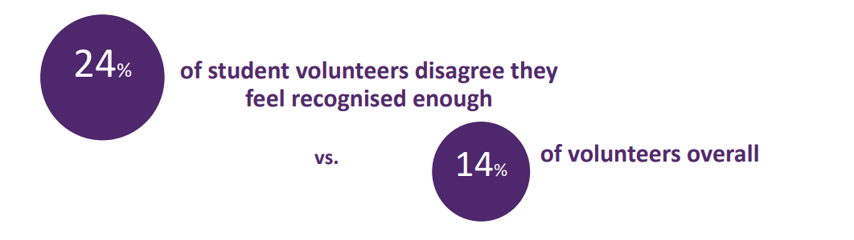
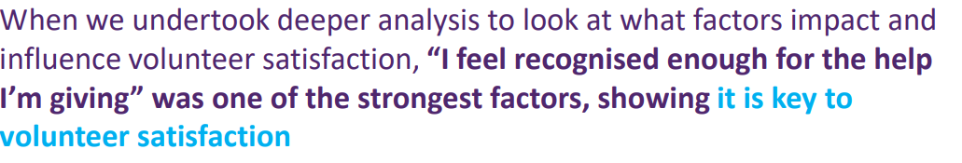
11
RECOGNITION
NVCO Survey 2023
Notes:
24% of student volunteers disagree they feel recognised enough compared to 14% of volunteers overall.

Slide 12
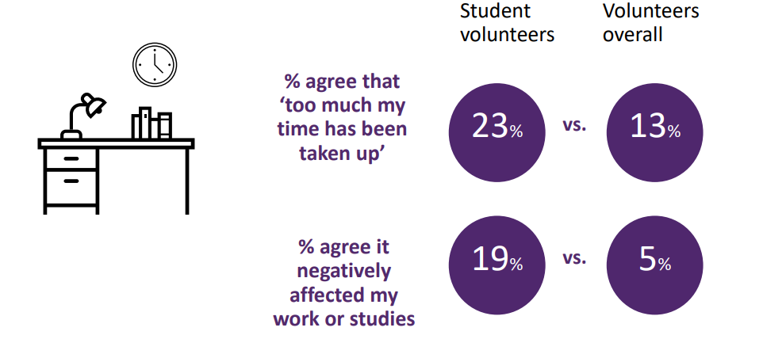
12
IMPACT TO STUDENTS
NVCO Survey 2023

Slide 13
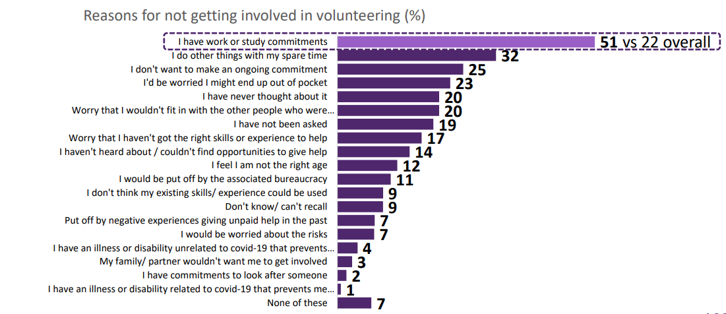
13
BARRIERS
NVCO Survey 2023
Notes:
Barriers to volunteering 51% or half of the student volunteers said they had work and study commitments compared to 22% of overall volunteers in the survey.

Slide 14
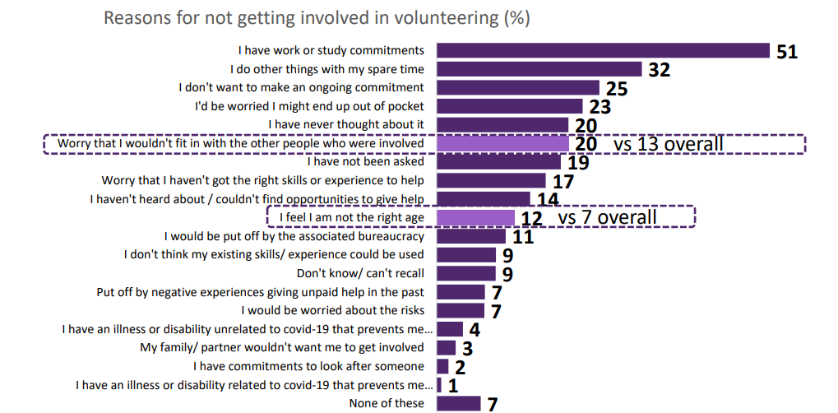
14
OTHER BARRIERS
NVCO Survey 2023
Notes:
Other barriers – 20% of student volunteers said that they worry that they wouldn’t fin in wit the other people who were involved compared to 13% of volunteers overall that took part in the survey.
12% felt that they were not the right age.

Slide 15
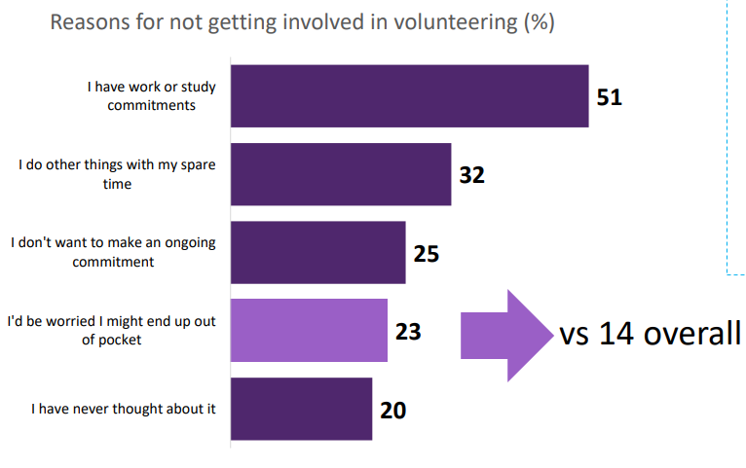
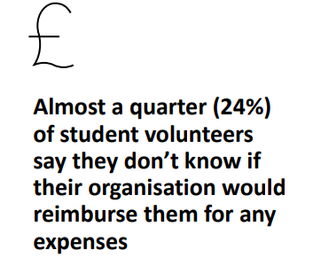
15
FINANCIAL BARRIERS
NVCO Survey 2023
Notes:
Since the cost of living crisis 23% nearly a quarter of student volunteers said they’d worry about being out of pocket, and didn’t know if their organisation would reimburse them for expenses. compared to 14% of volunteers overall that took part in the survey.

Slide 16
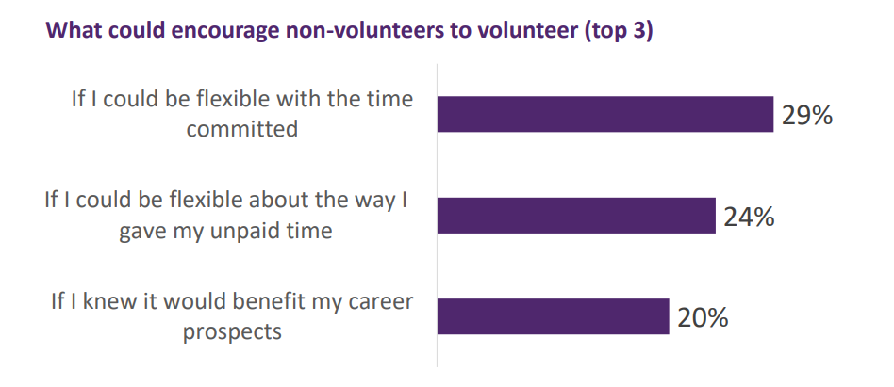
16
FLEXIBILITY
NVCO Survey 2023
Notes:
To encourage non-volunteers to volunteer they would like
Flexibility with the committed time
Flexibility about the way they give up unpaid time
To know that it would benefit career prospects.

Slide 17
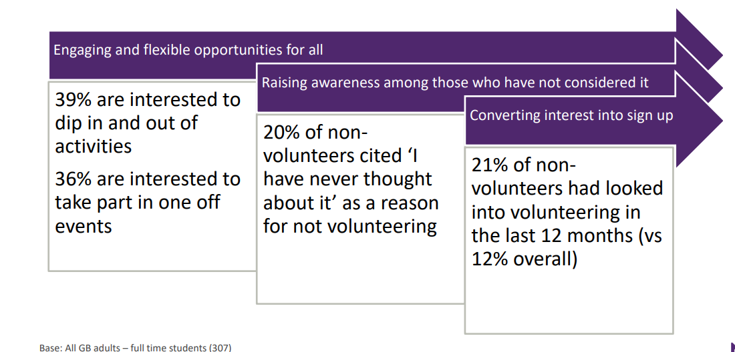
17
ENGAGING
NVCO Survey 2023

Slide 18
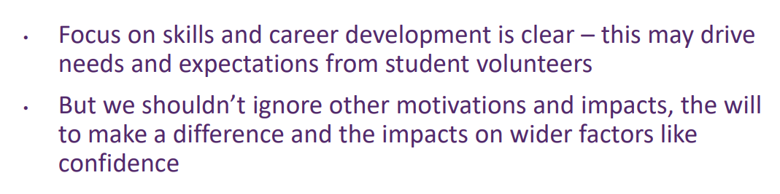
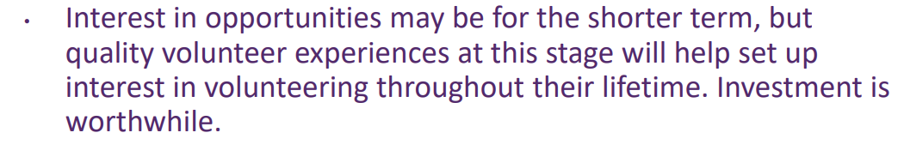
18
SKILLS & DEVELOPMENT
NVCO Survey 2023

Slide 19
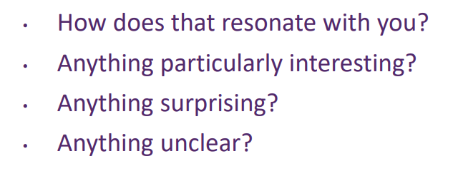
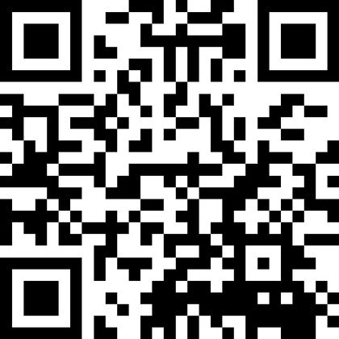
19
YOUR THOUGHTS
Go to www.slido.com
As a participant put in the code #3660274
NVCO Survey 2023
Notes:
Scan QR code or go to www.slido.com put in code #3660274
Answer the first question

Slide 20
NVCO Survey 2023
THANK YOU

