Slide 1
How to use Mentimeter
To elect Student Reps

Slide 2
What is Mentimeter
Mentimeter is a free presentation tool that is mainly used to create interactive presentations
It has quite a few useful functions in education, but for our purposes we are going to be using it to elect student reps
We believe this method will be easy to use and will help your students engage with the election process
It also has good analytics and export tools, which makes the final results easy to obtain and, if necessary, share with SUBU (we would only follow up if there’s allegations of foul play)

Slide 3
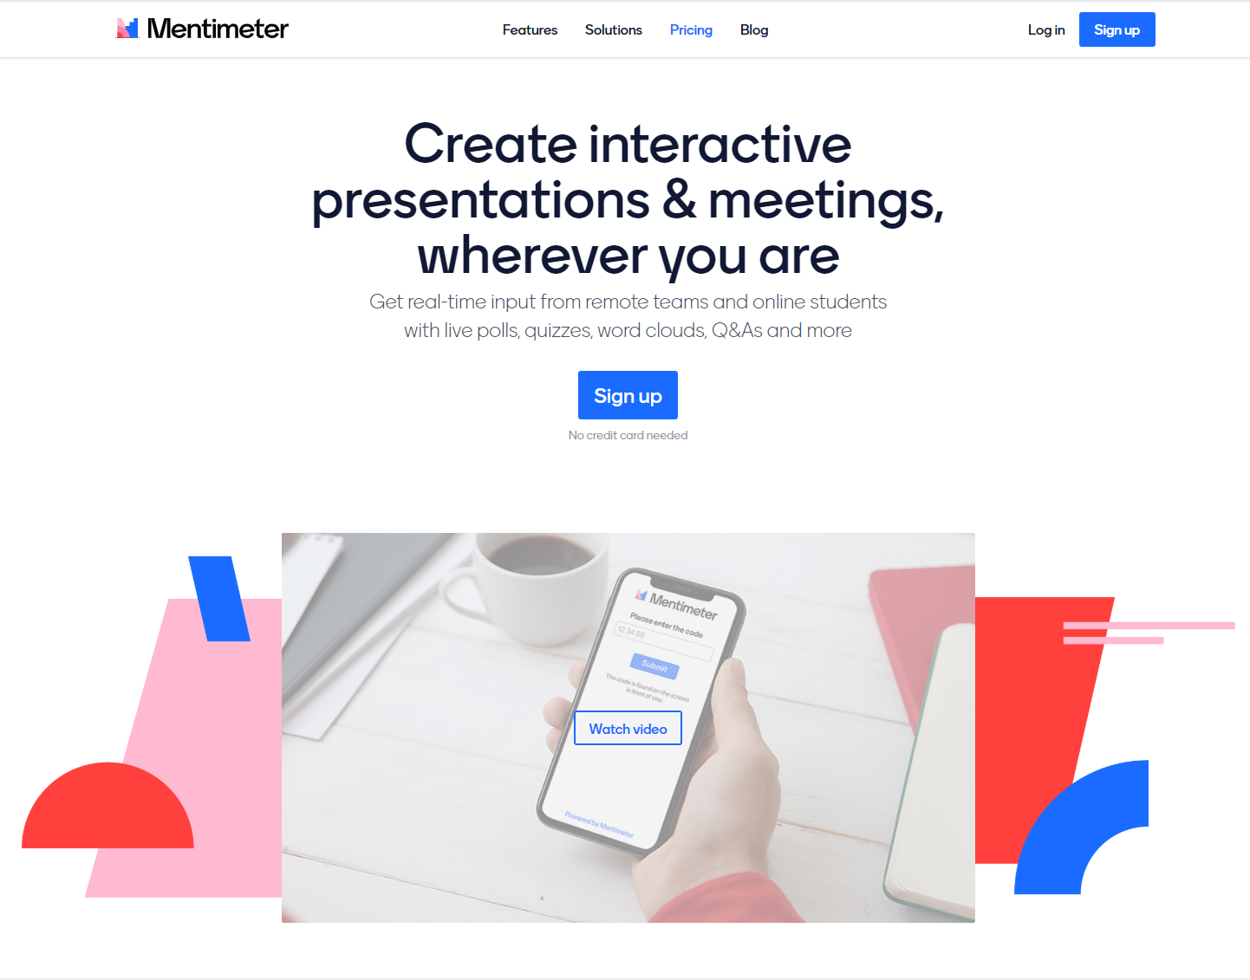
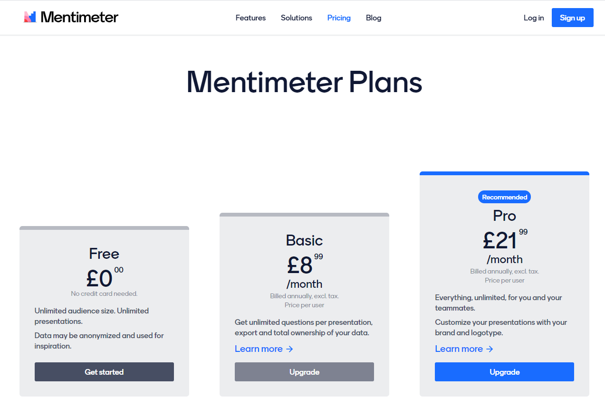
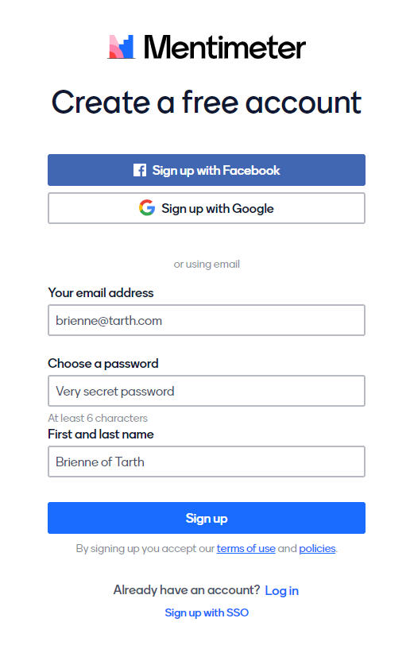
How to use Mentimeter
First, head onto www.mentimeter.com and select ‘pricing’ on the top menu. Don’t worry, the free version is fine for what we need it to do. Click on ‘get started’ under ‘Free’ and create an account.

Slide 4
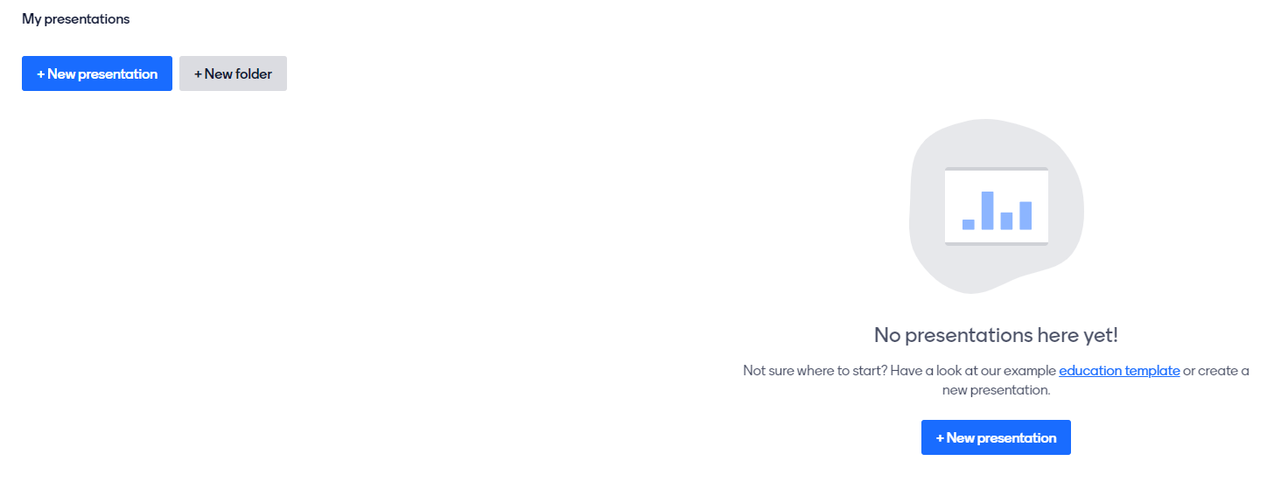
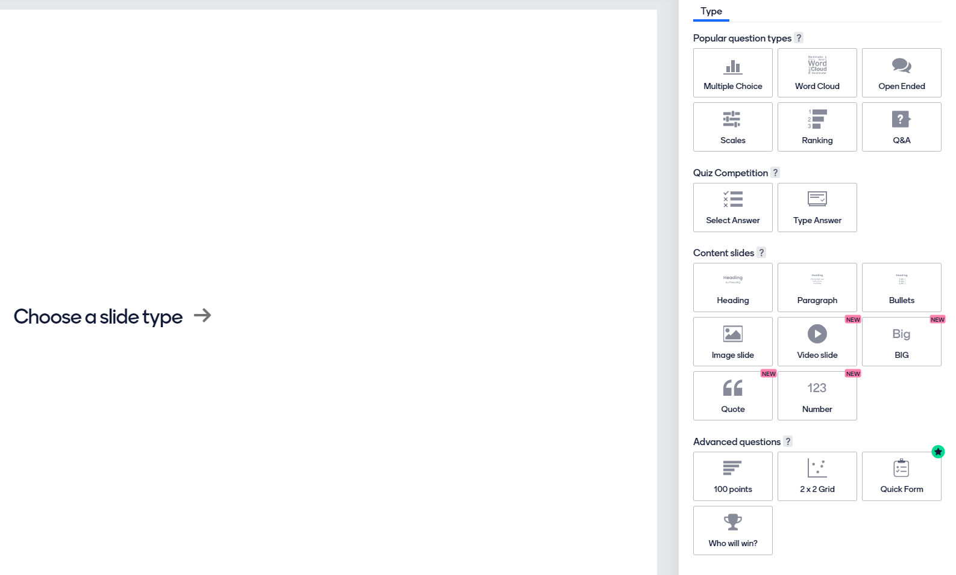
How to use Mentimeter
Once you’ve done that, click on ‘new presentation’, then select a slide type on the right hand side. In this case, we are going to choose ‘Multiple Choice’. You can choose ‘ranking’ or ‘who will win’, but this guide won’t cover those. If you would like to use these methods, please contact us.

Slide 5
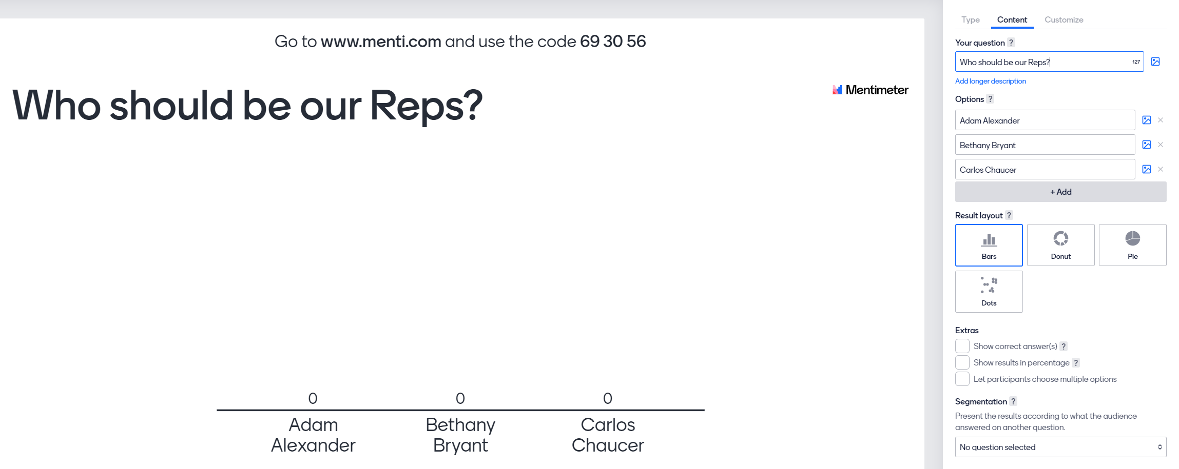
How to use Mentimeter
Next step is to add the candidates in the election. Select the ‘content’ tab on the top right, and add the candidates names as options. You may also want to change the name of the ‘Your Question’ section to whatever you want.
You may want to ‘let participants choose multiple options’ if you are choosing more than one candidate. The simplest would be to leave this unticked and just pick the top two candidates instead. If you would like to go with this method, click on the box and a slider will appear and then select how many Reps students are electing in total

Slide 6
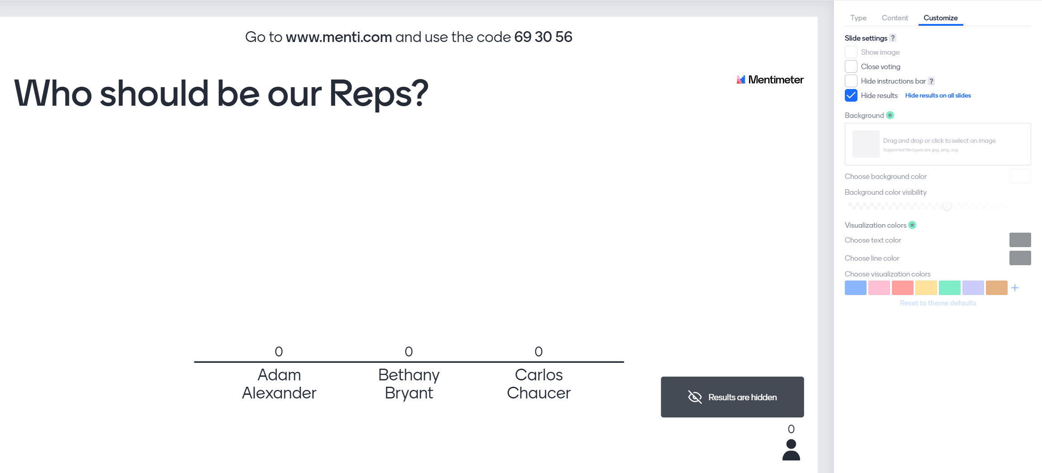
How to use Mentimeter
Next step is to click on the ‘customize’ tab and make sure that ‘hide results’ is ticked. This is so that you’re the only one that can see the results. You’re almost ready to make your election happen!

Slide 7
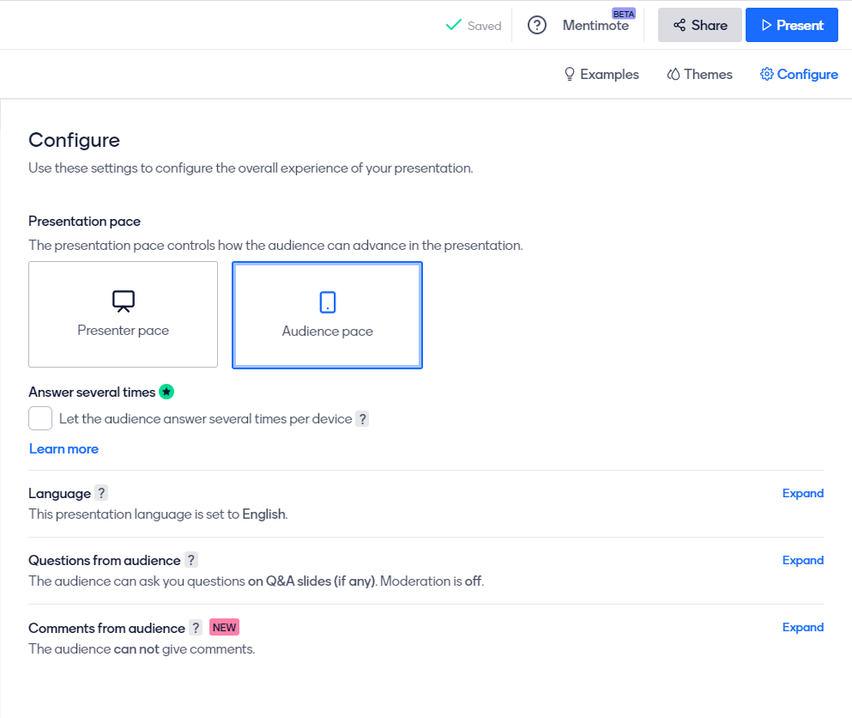
How to use Mentimeter
Just before you do though, you need to set the pace of the presentation. For this, click on ‘configure’ on the top right (just under present) and select ‘Audience pace’. This allows students to be able to vote if you have moved on from the presentation (specifically useful if doing the election over several days). Once you’ve done that, click on ‘present’.

Slide 8
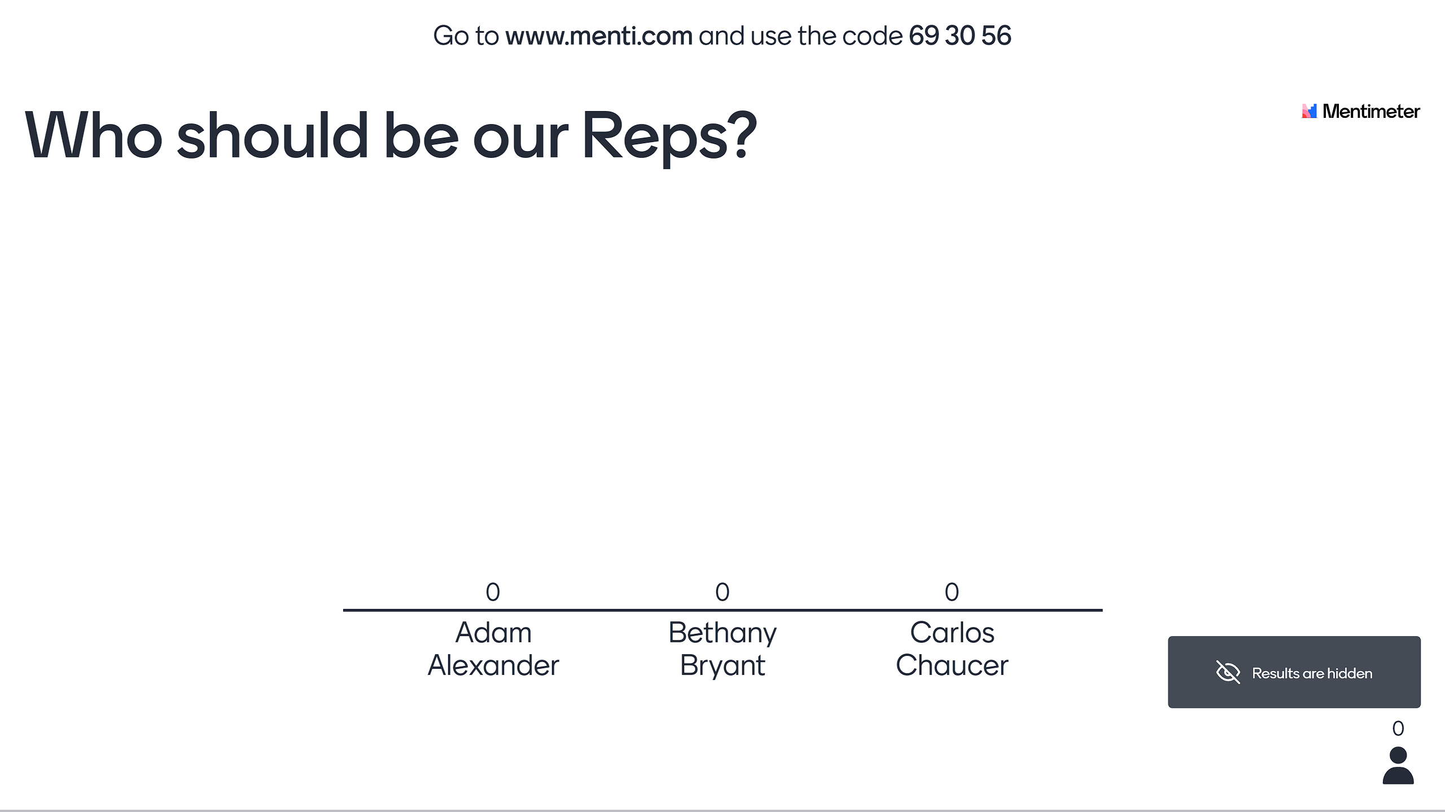
How to use Mentimeter
All students need to do is go to www.menti.com and input the code at the top of the screen (in this case 69 30 56) and they’ll be able to cast their vote. Note that students won’t be able to see the results live

Slide 9
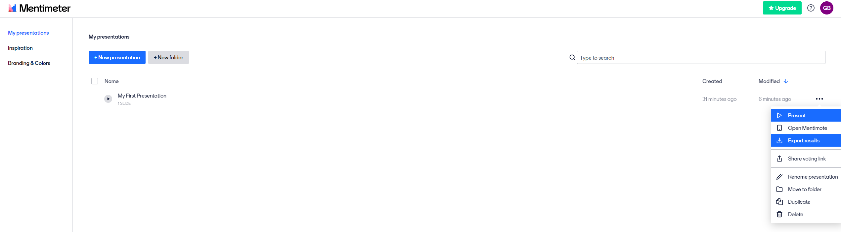
How to use Mentimeter
When your election period is over and you’re confident everyone has had a chance to vote, navigate back to the home page by clicking on ‘home’ on the top left. Then, you will see your presentation with 3 dots on the right. Click on this and select ‘export results.

Slide 10
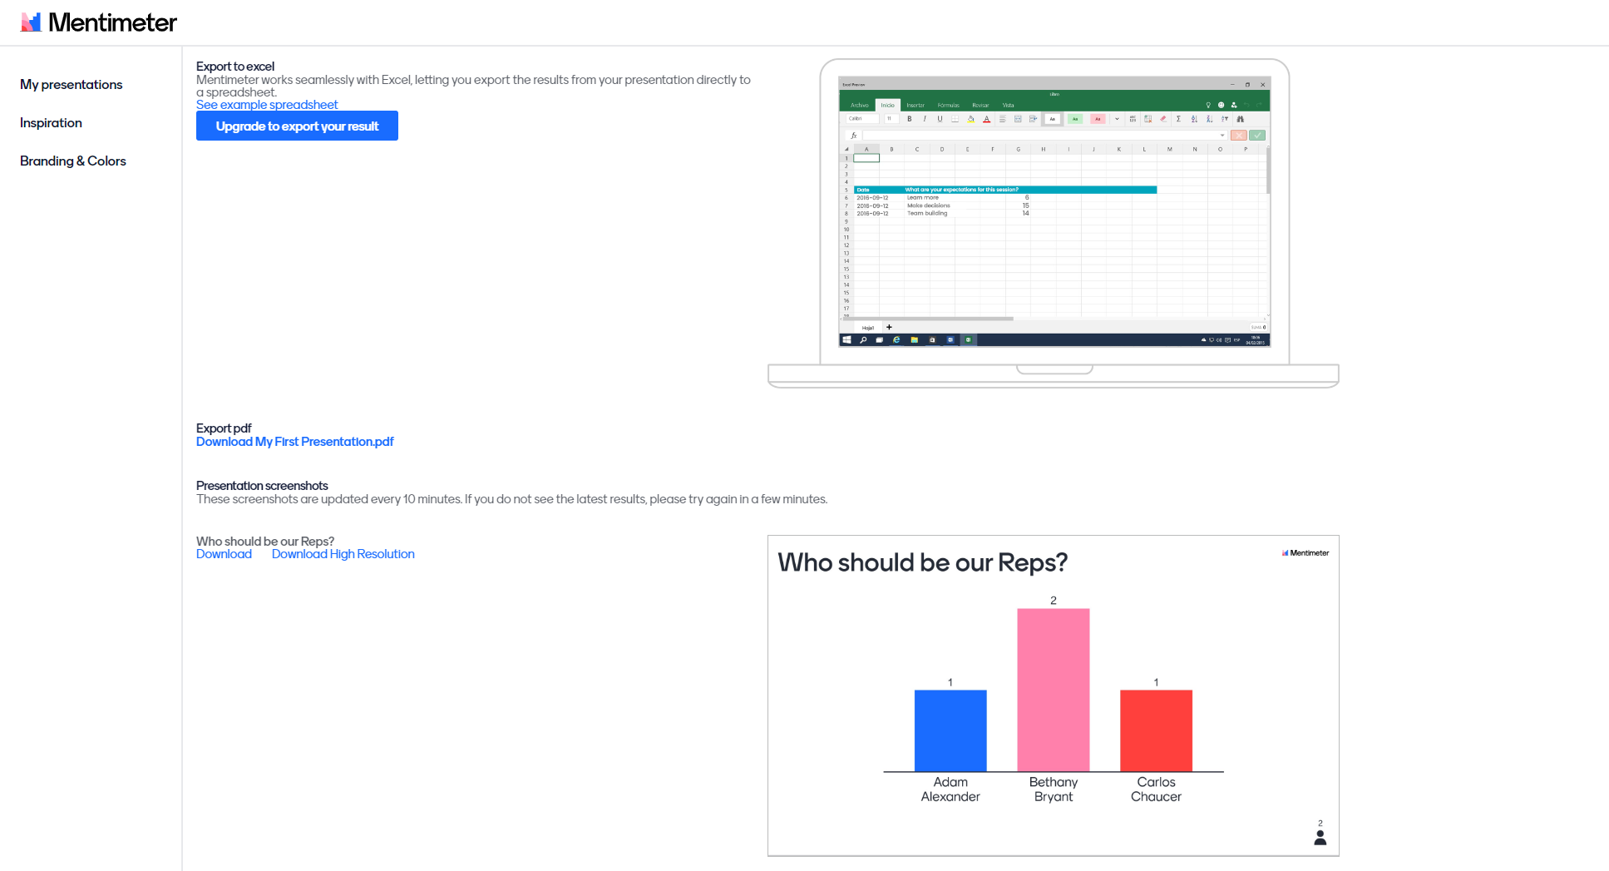
How to use Mentimeter
Once your election period is over, the results will show in this page. All you have to do is announce the winners and send them their Rep Welcome Letter which you’ll be able to find on our Staff Toolkit. That’s it! All done!

Slide 11
Thank you!
Thank you for reading this short guide. I hope it’s informative and you feel confident in using mentimeter for your Student Rep elections
This only shows you one method. Feel free to play around with other methods you might think are better
If you have any questions, please email scorder@bournemouth.ac.uk or Reps@bournemouth.ac.uk

